Slide 1
A NASSCOM-Timesjobs.Com Initiative
An opportunity for all the NAC & NAC-Tech test takers to improve their chances of employment . A platform that enables all test takers to create a bio-data/CV on Timesjobs.Com (India’s leading employment portal) and also embed /attach their NAC or NAC-Tech scores (whatever the case may be) in it.
From recruitment perspective, information about scores instantly helps an employer understand the potential of the candidates w.r.t. to various skills that they have been tested on through NAC /NAC-Tech test.
Note: This service is not available for those taking ‘NAC-Tech Diagnostic’ as Diagnostic Test is not conceptualized to be used for ‘employment’ purposes.

Slide 2
Important points
Only after the scores being published on NAC/NAC-Tech website, a test taker would be allowed to use this facility.
Following four fields in the resume form are used for ‘candidate verification’. If information in any of these four fields is different from what candidate has provided during online registration for NAC/NAC-Tech test, system will not allow him/her to attach the scores to the CV.
  NAC/NAC-Tech Registration ID
  First Name
  Last Name
  Date of Birth
To maintain the authenticity/genuineness of the scores, candidates will not be allowed to write in their scores in the CV manually; rather the scores will automatically get attached to the CV during the process.
If one does not remember the Registration ID, he/she should visit NAC/NAC-Tech website and use ‘forgot password’ to retrieve the same.
Once the scores are successfully attached , candidate will not be able to see the same in his/her CV; however, the scores will be viewable by respective employers who look at the CV. The scores are shown to employers on each skill, exactly how it is shown in NAC/NAC-Tech score card.
Disclaimer: Decision to interview/shortlist any candidate through Timesjobs.Com is solely at
the discretion of the employers and NASSCOM does not have any intervention in
that.

Slide 3


Slide 4
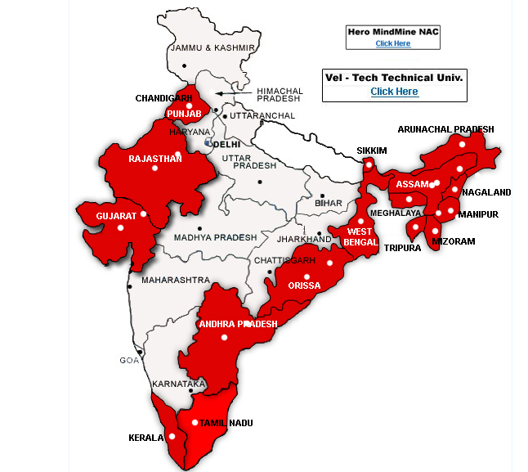
Step 1
Visit the NAC (www.nac.nasscom.in) / NAC-Tech (www.nac.nasscom.in/nactech) website and visit the webpage of the state you belong to (via India map)

Slide 5
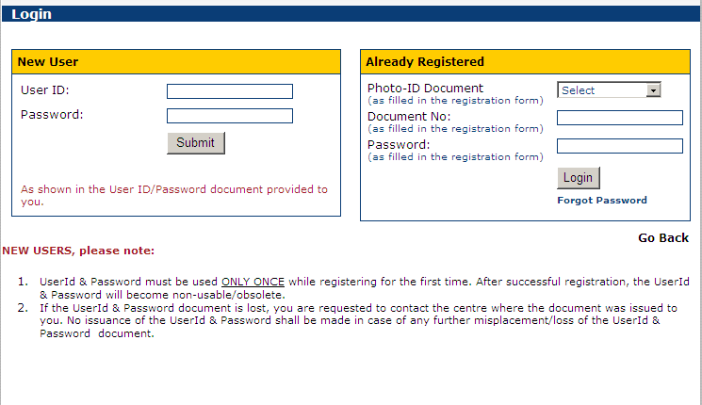
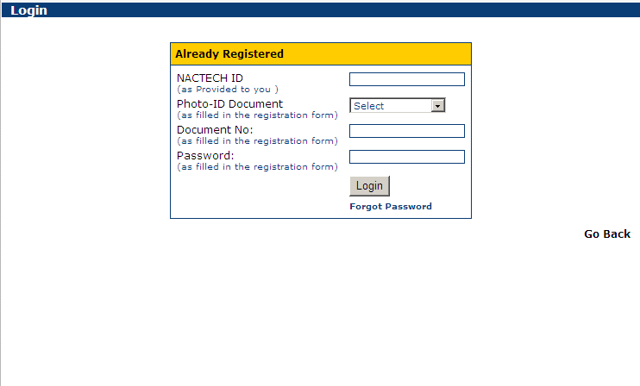
Step 2
Log in to the personal account through ‘Already Registered’ window
NAC NAC-TECH
* If one does not remember the Reg. ID or Password, ‘forgot password’ functionality should be used to retrieve the log-in details

Slide 6
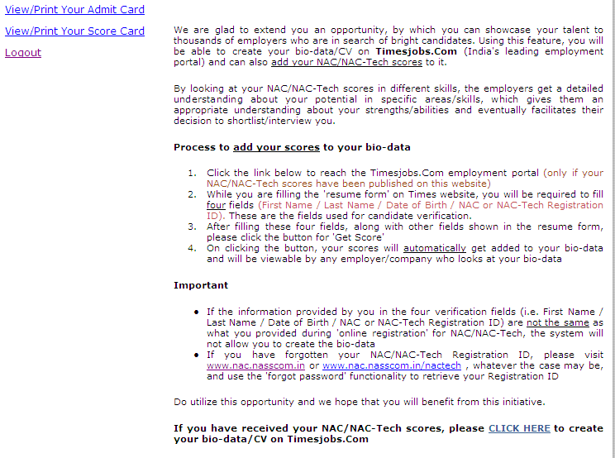
Step 3
After logging in to the account, click ‘click here’ to go to Timesjobs.Com website

Slide 7
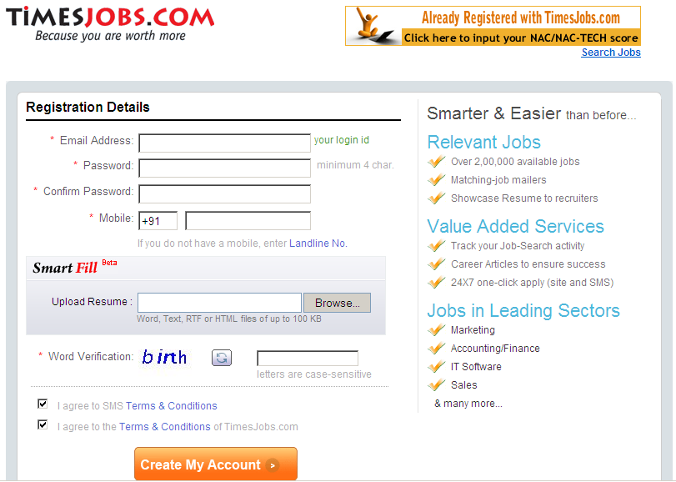
Step 4
On visiting Timesjobs.Com website, fill the desired details in the fields shown and click ‘Create My Account’

Slide 8
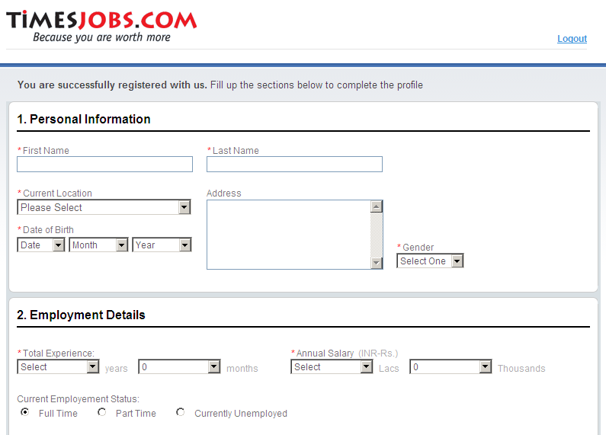
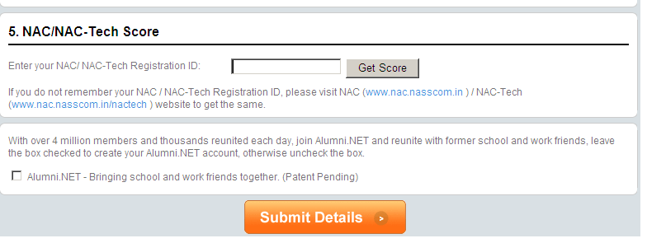
Step 5
On successful creation of account, fill the ‘resume form’. This form also asks for the NAC/NAC-Tech Reg. ID. After filling the whole form along with NAC/NAC-Tech Reg. ID, click ‘Get Score’ to insert /attach the scores in the CV.
* If one does not remember the Reg. ID, he/she should visit the NAC/NAC-Tech website (as the case may be) and use the ‘forgot password’ functionality to retrieve the log-in details

Slide 9
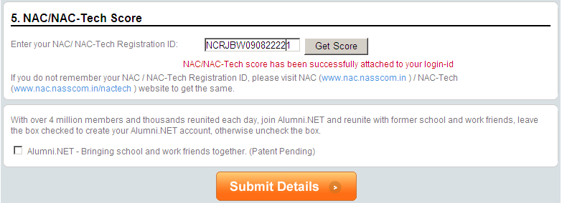
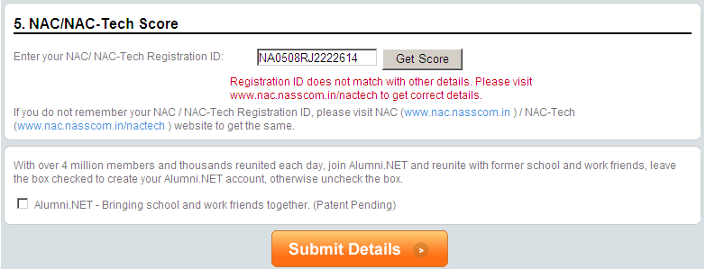
Step 5... (contd.)
… however, incorrect details will not let the user insert scores to the CV
After clicking ‘Get Score’, if details (including Reg. ID) provided by the candidate are correct, message will appear confirming successful attachment of scores to the CV

Slide 10
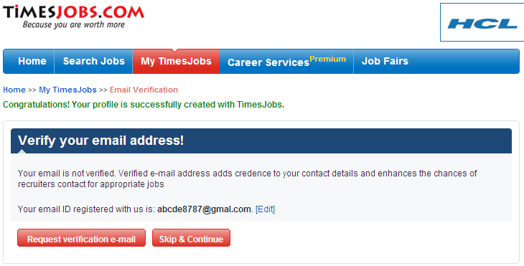
Step 6
On filling the complete form and successfully attaching the scores to the CV, click ‘Submit Details’ to submit the resume form
Upon submission of resume form, the message, confirming successful CV creation with Timesjobs.Com, will appear
END OF PROCESS FOR THOSE WHO ARE NOT ALREADY REGISTERED WITH TIMESJOBS.COM

Slide 11


Slide 12
Step 1
Visit the NAC (www.nac.nasscom.in) / NAC-Tech (www.nac.nasscom.in/nactech) website and visit the webpage of the state you belong to (via India map)

Slide 13
Step 2
Log in to the personal account through ‘Already Registered’ window
NAC NAC-TECH
* If one does not remember the Reg. ID or Password, ‘forgot password’ functionality should be used to retrieve the log-in details

Slide 14
Step 3
After logging in to the account, click ‘click here’ to go to Timesjobs.Com website

Slide 15
Step 4
On visiting Timesjobs.Com website, click the ‘Already Registered with Timesjobs.Com’ banner

Slide 16

Step 5
Log in with the Timesjobs.Com User ID/Password to access the existing CV

Slide 17
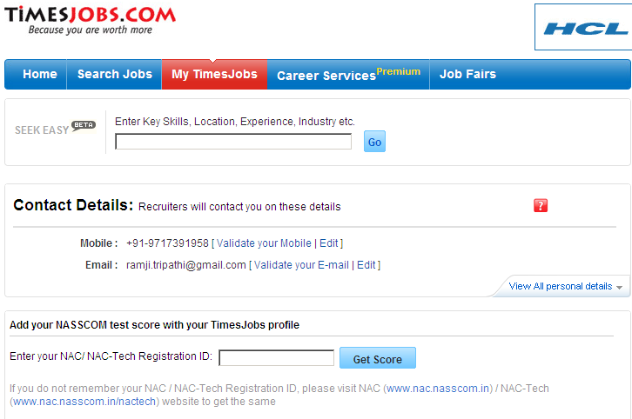
Step 6
Enter the NAC/NAC-Tech Registration ID in the given field and click ‘Get Score’ to insert/attach the scores to the existing CV

Slide 18
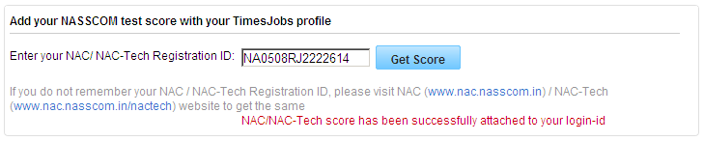
Step 6... (contd.)
After clicking ‘Get Score’, if details (including Reg. ID) provided by the candidate are correct, message will appear confirming successful attachment of scores to the CV
END OF PROCESS FOR THOSE WHO ARE ALREADY REGISTERED WITH TIMESJOBS.COM AND ARE ATTACHING THEIR NAC/NAC-TECH SCORES TO THE CV

